Slide 1

Digital Signal Processing
Final Presentation
Presented By:
MOHAMMAD ANWAR KHAN
Student ID : M0829018
Advisor: Wann-Yun Shieh
Computer Science and Information Engineering (CSIE)
Chang Gung University, Taoyuan City 33302, Taiwan (R.O.C.)

Slide 2
Research Preview: A Microphone and FSR based portable non-invasive swallowing assessment device
Computer Science and Information Engineering (CSIE)
Chang Gung University, Taoyuan City 33302, Taiwan (R.O.C.)

Slide 3
Layout:
Introduction
Background/Motivation
Objective
On-going work
Future Work
Computer Science and Information Engineering (CSIE)
Chang Gung University, Taoyuan City 33302, Taiwan (R.O.C.)

Slide 4
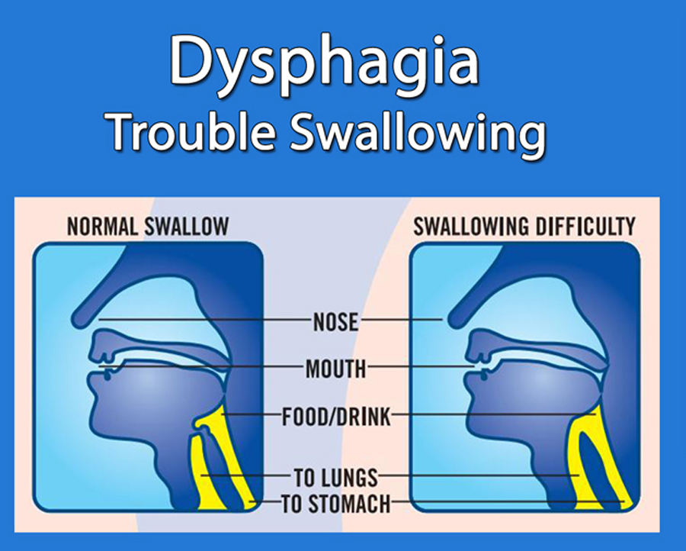
Introduction(Contd.):
Dysphagia is the difficulty in swallowing process.
Most common of these causes are diseases and disorders such as:
Strokes
Cancer
As a result, monitoring and managing dysphagia is of utmost importance.
Therefore, development of a portable inexpensive and Non-invasive swallowing assessment device.
Computer Science and Information Engineering (CSIE)
Chang Gung University, Taoyuan City 33302, Taiwan (R.O.C.)

Slide 5
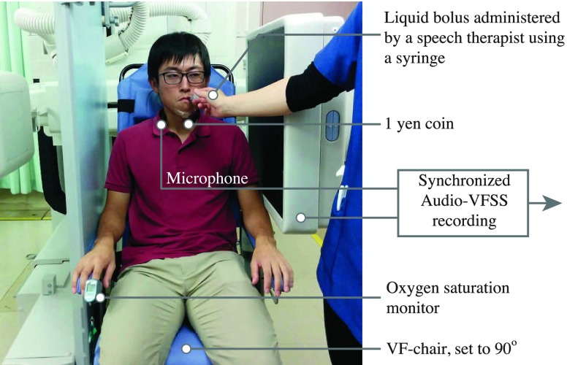
Background/Motivation:
The VFSS (Videofluroscopic) is the current method of assessment for swallowing disorder detection and monitoring, but it has limitations, such as:
Limited availability.
Expensive.
Radiation risk.
Needs barium ingestion.
A VFSS evaluation under process
Computer Science and Information Engineering (CSIE)
Chang Gung University, Taoyuan City 33302, Taiwan (R.O.C.)

Slide 6
Objective:
To create a microphone and fsr(force sensing resistor) based portable non-invasive swallowing assessment device.
To compare and establish a connection between the audio signal patterns with the existing evaluation methods for dysphagia such as FSR.
After the comparison alongside different sensors, there’s a plan to integrate all of them in one place and help enhance the result.
Computer Science and Information Engineering (CSIE)
Chang Gung University, Taoyuan City 33302, Taiwan (R.O.C.)

Slide 7
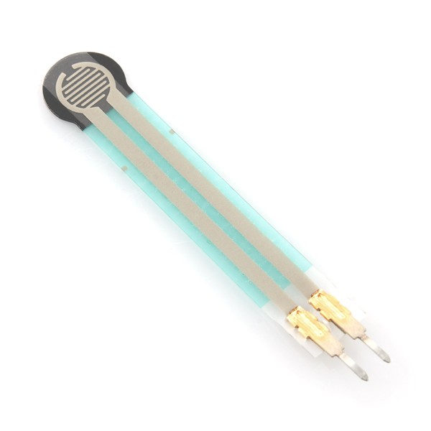
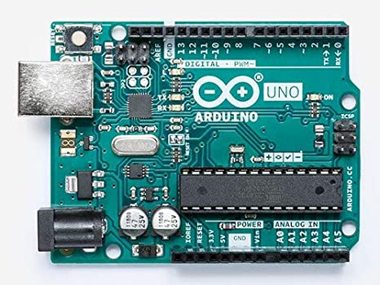
On-going work:
Making it portable using Arduino Uno board.
Force sensing resistor
Computer Science and Information Engineering (CSIE)
Chang Gung University, Taoyuan City 33302, Taiwan (R.O.C.)
Notes:
A force-sensing resistor is a material whose resistance changes when a force, pressure or mechanical stress is applied

Slide 8
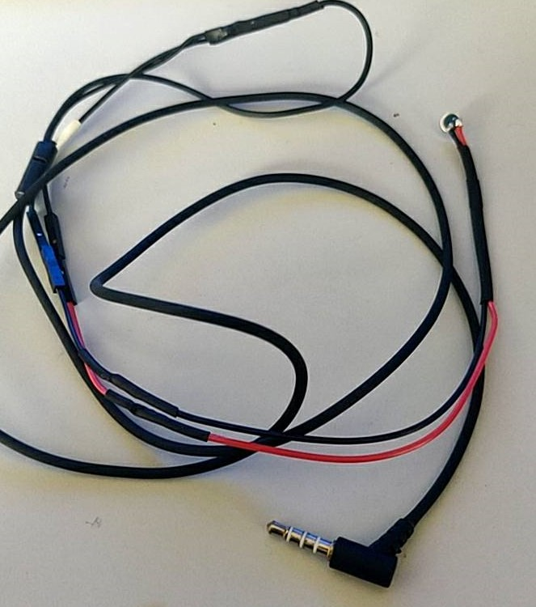
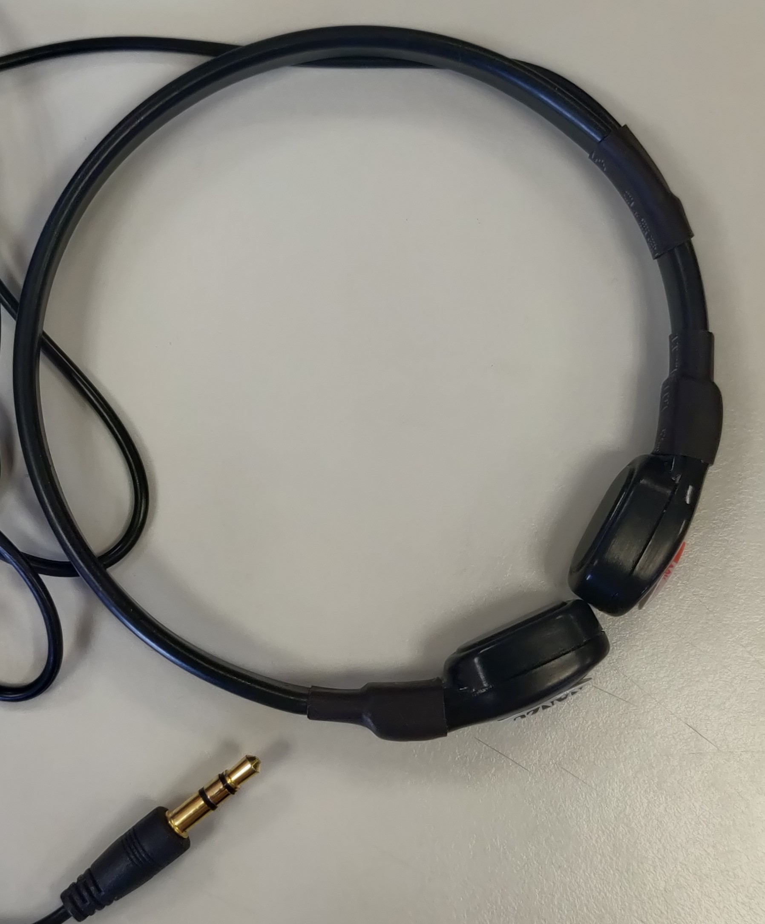
On-going work:
Modifying the device for swallowing sound assessment.
High sensitive microphone
Computer Science and Information Engineering (CSIE)
Chang Gung University, Taoyuan City 33302, Taiwan (R.O.C.)

Slide 9
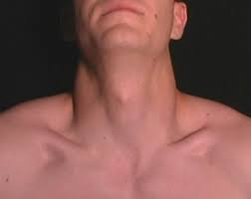

Sensors:
Sensor arrangement on patient’s neck.
Force Resistive Sensor
High sensitive microphone
Computer Science and Information Engineering (CSIE)
Chang Gung University, Taoyuan City 33302, Taiwan (R.O.C.)

Slide 10
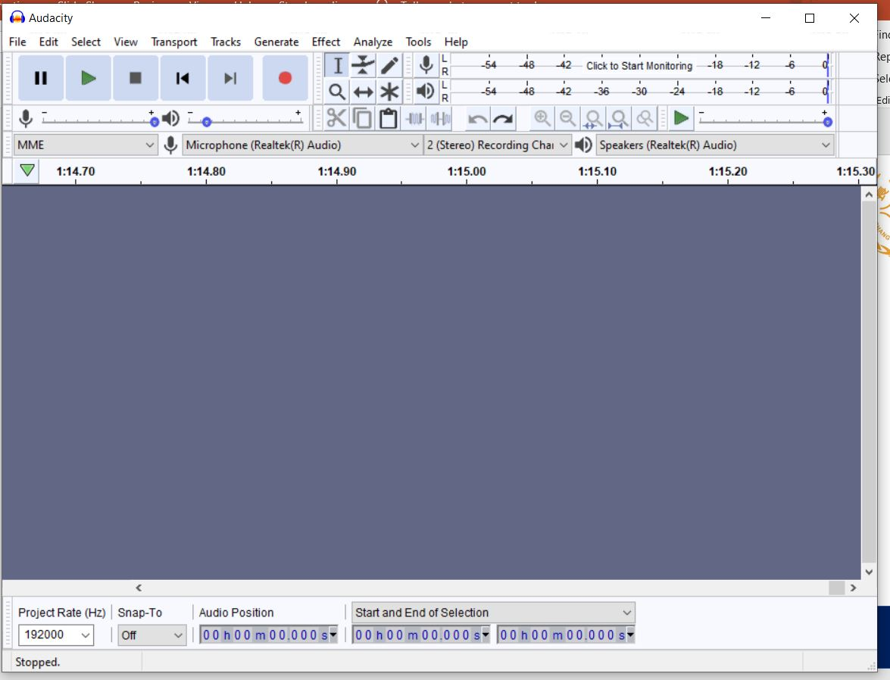
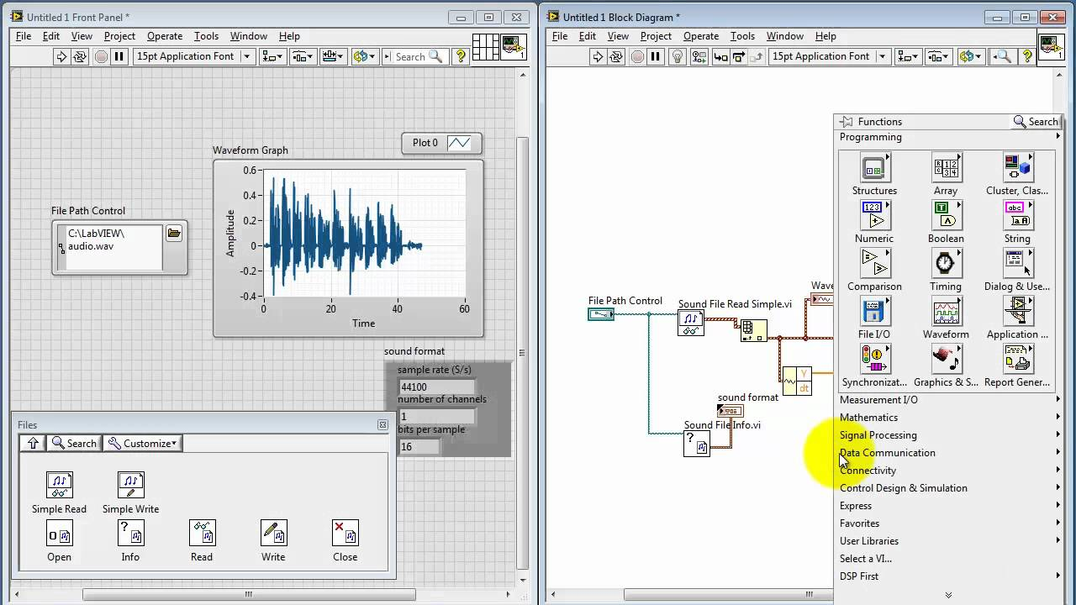
Software(s)
Audacity
Labview
Computer Science and Information Engineering (CSIE)
Chang Gung University, Taoyuan City 33302, Taiwan (R.O.C.)

Slide 11
Why LabVIEW and not python?
In python for signal detection a separate program for Arduino and the graph interpretation has to be written with different set of libraries, whereas in LabVIEW it can be performed under one window.
The Arduino code generates value in numeric data as opposed to graphical data in normal circumstances also segment detection is easy when comparing in graphs as opposed to numerical values.
Computer Science and Information Engineering (CSIE)
Chang Gung University, Taoyuan City 33302, Taiwan (R.O.C.)

Slide 12
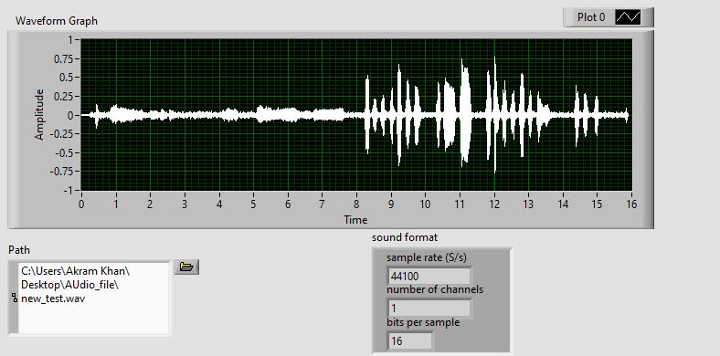
On-going work:
Assessment for sound waves.
Computer Science and Information Engineering (CSIE)
Chang Gung University, Taoyuan City 33302, Taiwan (R.O.C.)

Slide 13
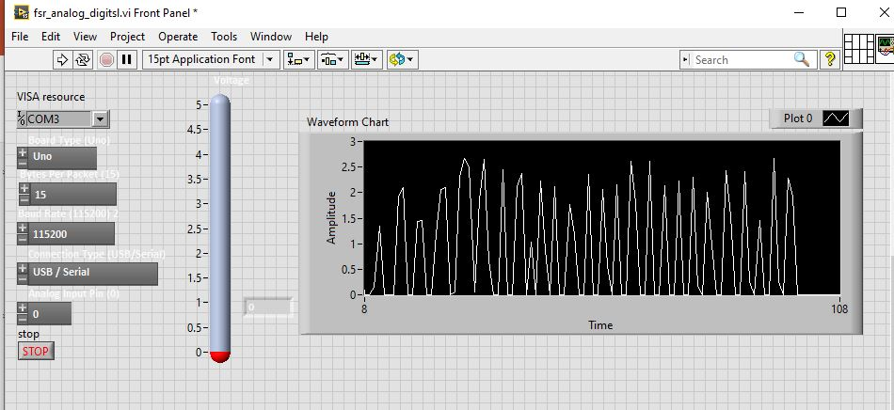
On-going work:
Assessment for FSR signals.
Computer Science and Information Engineering (CSIE)
Chang Gung University, Taoyuan City 33302, Taiwan (R.O.C.)

Slide 14
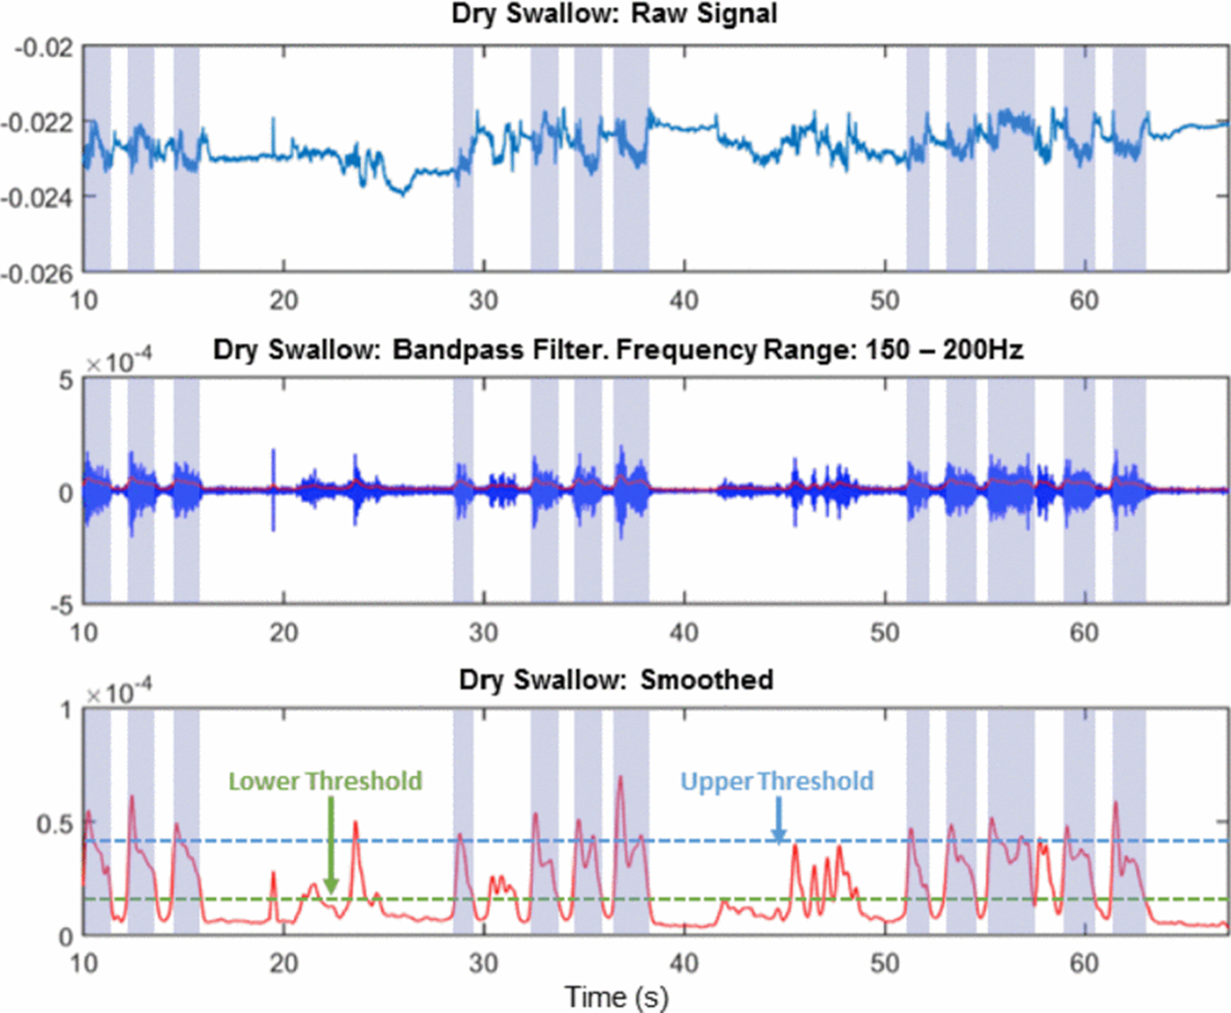
Applying filters(yet to be performed):
With the gathered signals in waveforms for sound and fsr I still have to apply bandpass filter (range yet to be determined) to reduce the noise.
Then to further smooth it and for better detection of a complete swallow I need to set lower and upper threshold value.
Computer Science and Information Engineering (CSIE)
Chang Gung University, Taoyuan City 33302, Taiwan (R.O.C.)

Slide 15
Future Work:
Reduce the surface and recording environment noise while capturing the signals.
Calibrating the bandpass filter range.
Creating an autodetection swallow program for healthy and dysphagic swallow
If needed the device might integrate several sensors to increase the quality of assessment.
Applying the resultant device to real world.
Computer Science and Information Engineering (CSIE)
Chang Gung University, Taoyuan City 33302, Taiwan (R.O.C.)

Slide 16
Thank You…
Computer Science and Information Engineering (CSIE)
Chang Gung University, Taoyuan City 33302, Taiwan (R.O.C.)

